Slide 1
Introduction To Azure Virtual Networks.
Tashik Moin MLSA, Microsoft. Tashik.Moin@StudentAmbassadors.Com
References Microsoft Ignite Microsoft Learn MSDN
Notes:
Good morning! I'm [ YOUR NAME ] and I'm absolutely thrilled to join you in [ CITY YOU ARE IN ].
Azure provides compute, storage and networking for the cloud
If you're new to Azure, or the cloud, it can be intimidating
This session will cover the essential concepts you'll need to get off and running with Azure networking

Slide 2
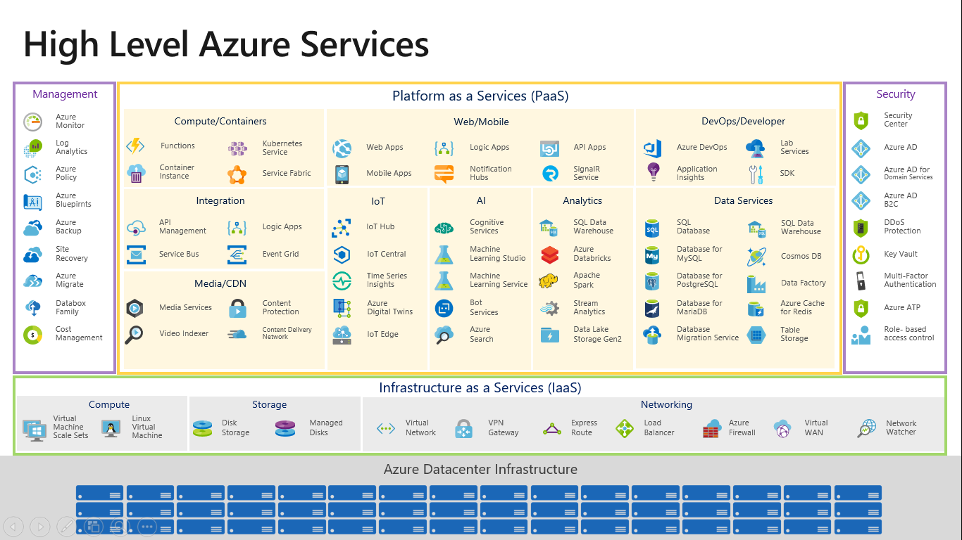

Slide 3
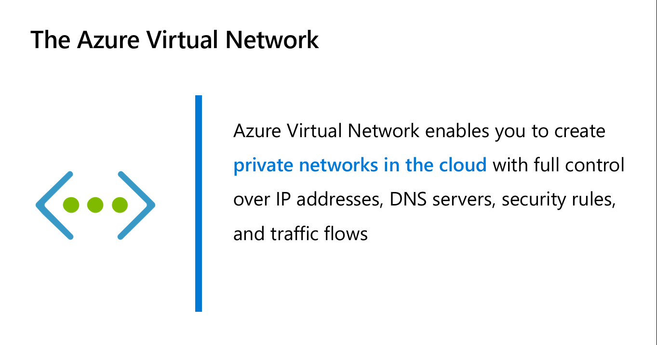

Slide 4
Introduction To IPV4

Slide 5
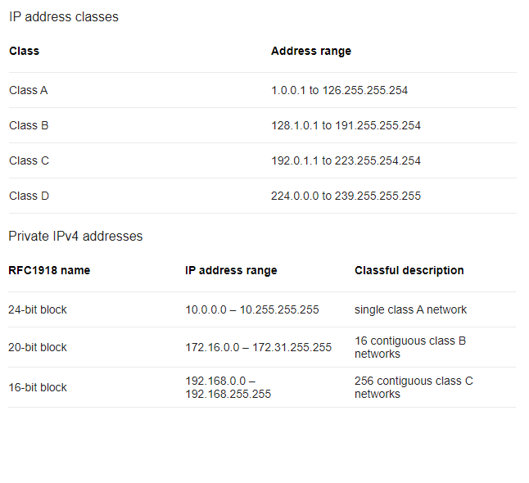

Slide 6
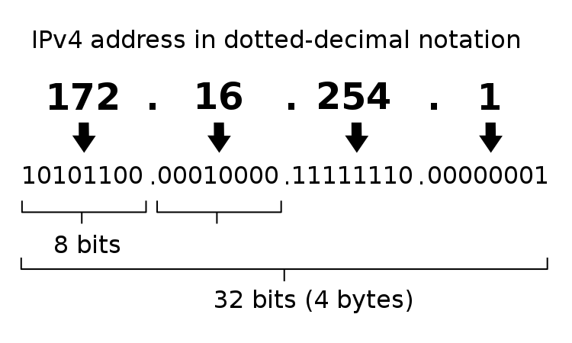

Slide 7
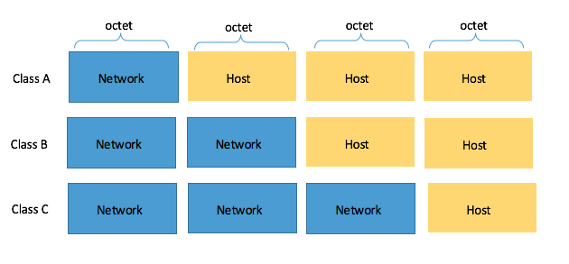

Slide 8
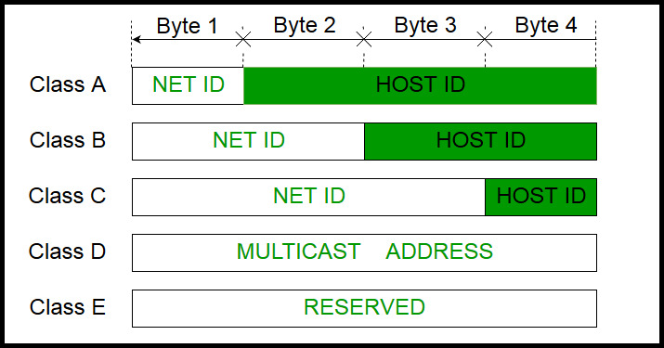

Slide 9
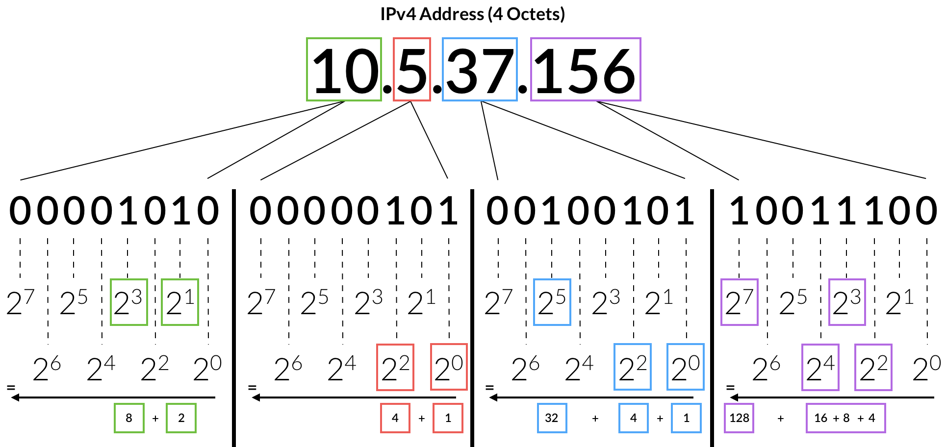

Slide 10
Introduction To Subnetting

Slide 11
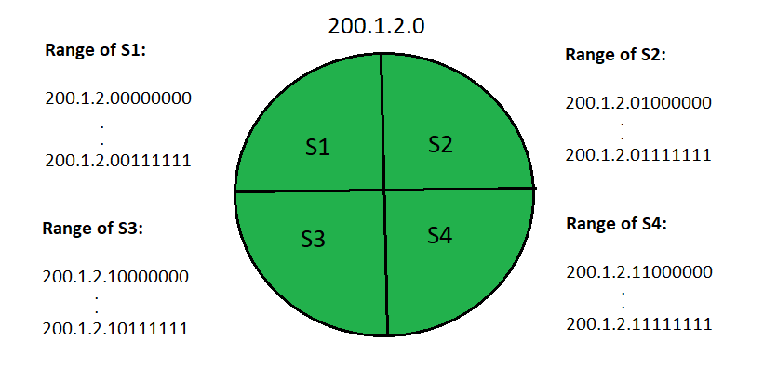
Address Space

Slide 12
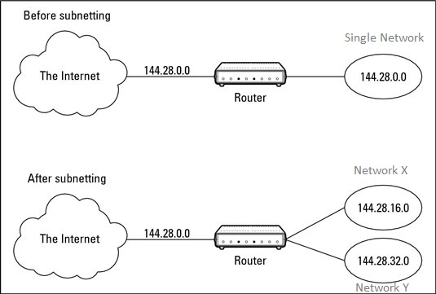

Slide 13
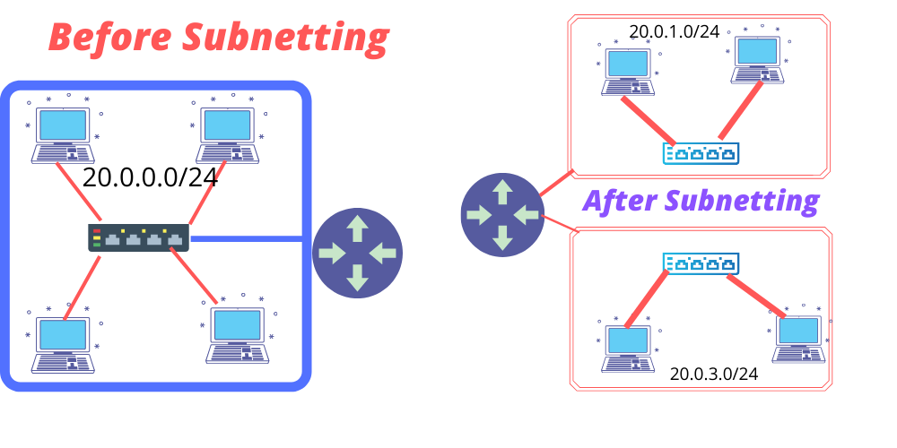

Slide 14
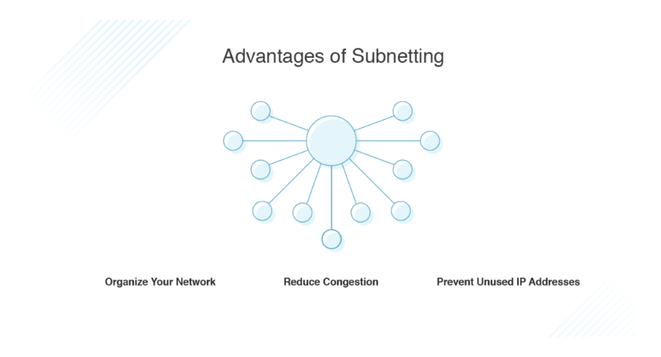

Slide 15
Why Subnets ?
Subnets offer a way of organizing your network to help to reduce network congestion. When you have a lot of traffic flowing between particular parts of your network, it can help to group those parts in a single section, so the traffic doesn’t have to travel across the entire network to get from place to place. Separating out small parts of your network into subnets allows traffic to flow more quickly and to avoid taking unnecessary routes, adding traffic where it isn’t needed.
In addition, subnetting helps in efficiently allocating IP addresses and prevents large numbers of IP addresses from going unused. Subnets are usually set up geographically for particular offices, or for particular teams within a business to allow their network traffic to stay within the location.

Slide 16
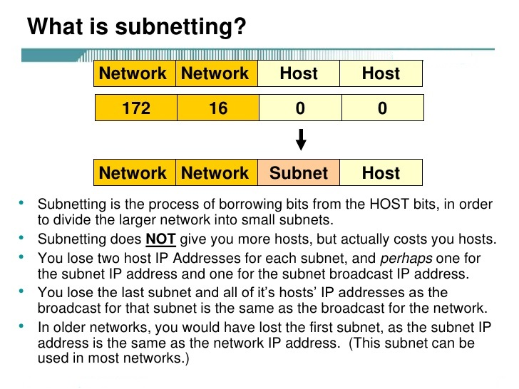

Slide 17
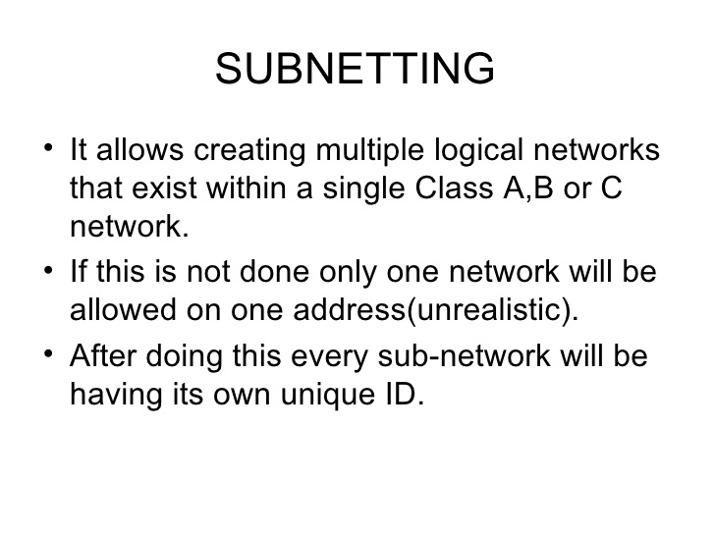

Slide 18
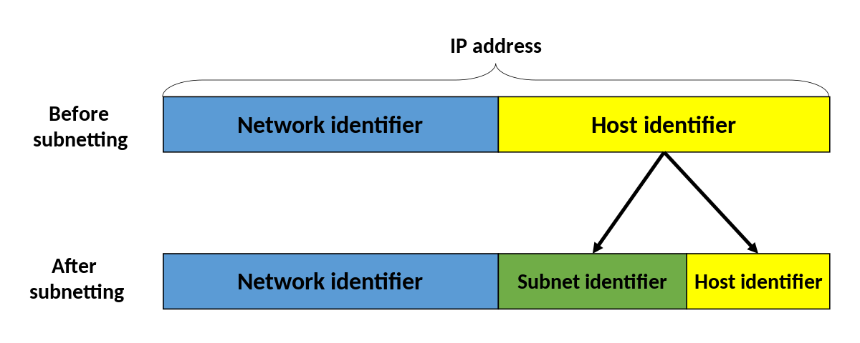

Slide 19
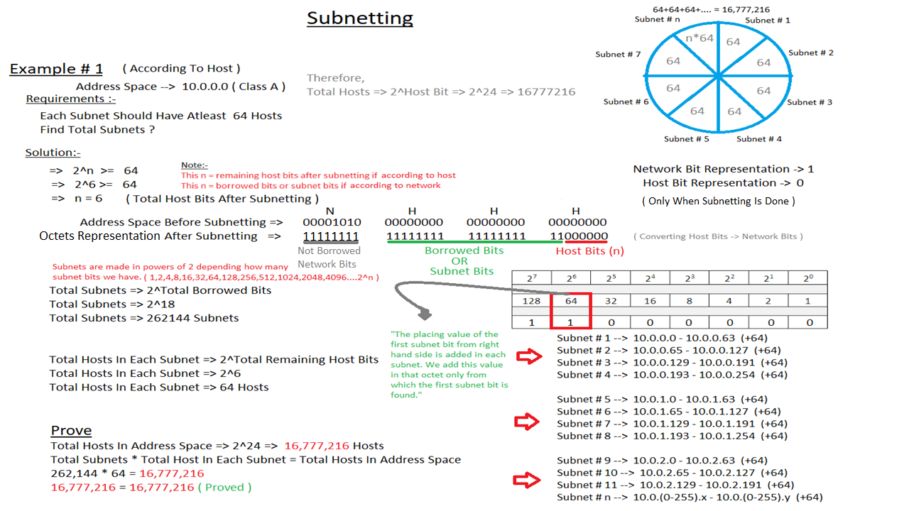

Slide 20
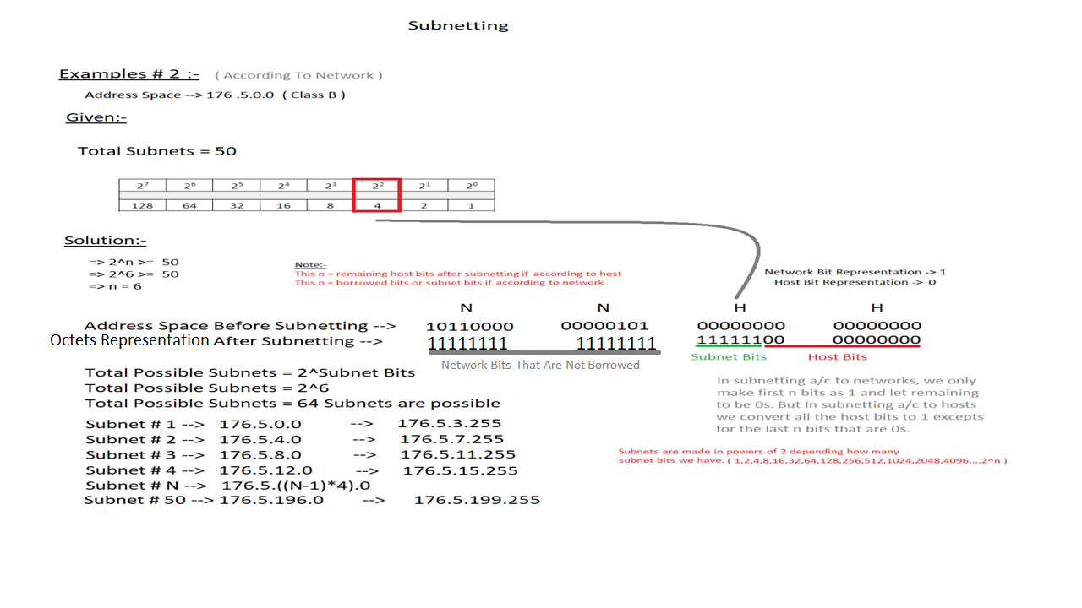

Slide 21
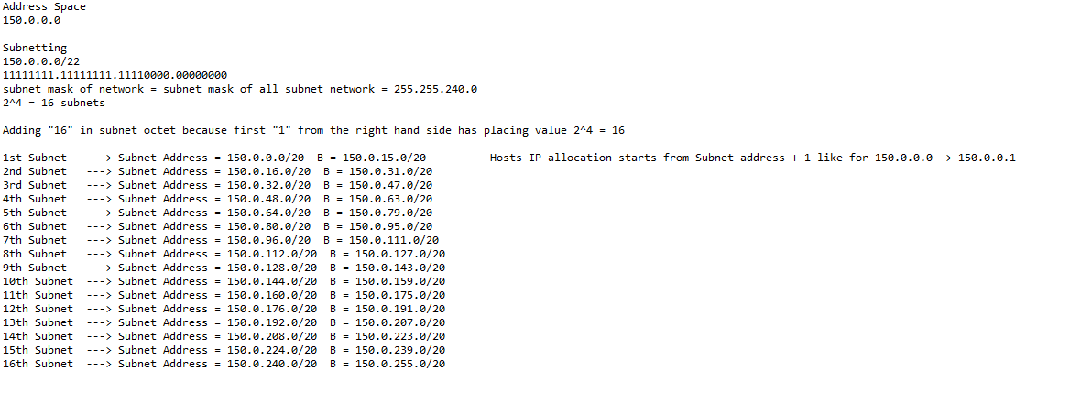

Slide 22
Connecting 3 Subnets using static routing in Packet Tracer

Slide 23
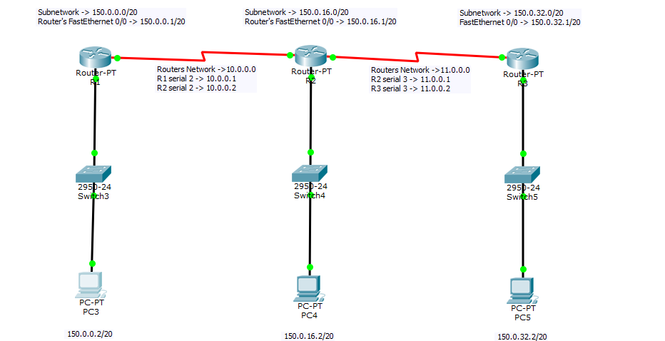

Slide 24
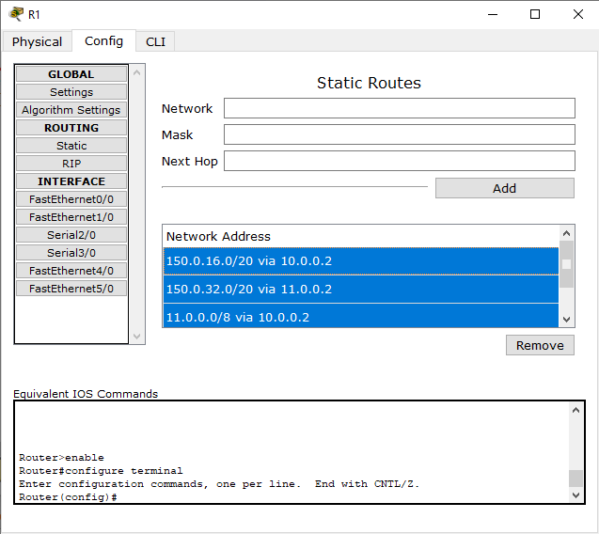

Slide 25
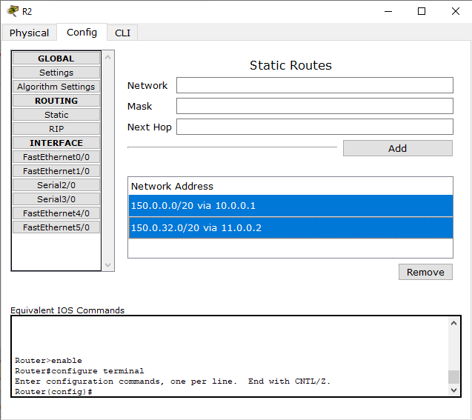

Slide 26


Slide 27
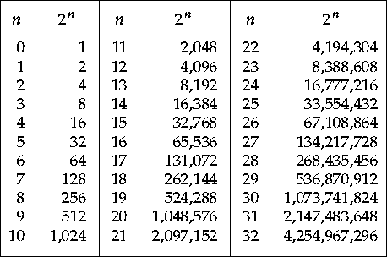
Powers Of 2

Slide 28
Classless Inter-Domain Routing (CIDR) Notation.
Classless Inter-Domain Routing (CIDR) is a method for allocating IP addresses and for IP routing. The Internet Engineering Task Force introduced CIDR in 1993 to replace the previous classful network addressing architecture on the Internet. Its goal was to slow the growth of routing tables on routers across the Internet, and to help slow the rapid exhaustion of IPv4 addresses.
IP addresses are described as consisting of two groups of bits in the address: the most significant bits are the network prefix, which identifies a whole network or subnet, and the least significant set forms the host identifier, which specifies a particular interface of a host on that network. This division is used as the basis of traffic routing between IP networks and for address allocation policies. Whereas classful network design for IPv4 sized the network prefix as one or more 8-bit groups, resulting in the blocks of Class A, B, or C addresses, under CIDR address space is allocated to Internet service providers and end users on any address-bit boundary.
It is based on variable-length subnet masking (VLSM) which allows the specification of arbitrary-length prefixes. CIDR introduced a new method of representation for IP addresses, now commonly known as CIDR notation. CIDR introduced an administrative process of allocating address blocks to organizations based on their actual and short-term projected needs. N N Subnet H
Example: 10.0.0.0/18 → 11111111 11111111 11000000 00000000

Slide 29
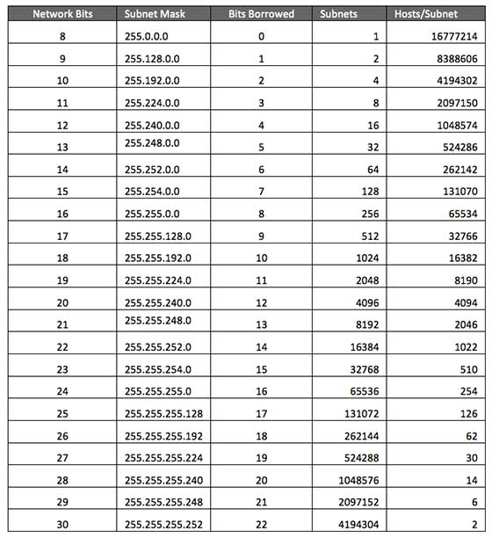
Subnet Mask Calculation
“Add placing values of all 1’s in subnet octet ( octet in which last bit is borrowed ) “ Placing Values -> 128 64 32 16 8 4 2 1
Bit Number -> 7 6 5 4 3 2 1 0 Example :- Bit Borrowed -> 0 11111111 00000000 00000000 00000000 Bit Borrowed -> 1 11111111 10000000 00000000 00000000 Bit Borrowed -> 2 11111111 11000000 00000000 00000000 Bit Borrowed -> 3 11111111 11100000 00000000 00000000 Bit Borrowed -> 4 11111111 11110000 00000000 00000000

Slide 30
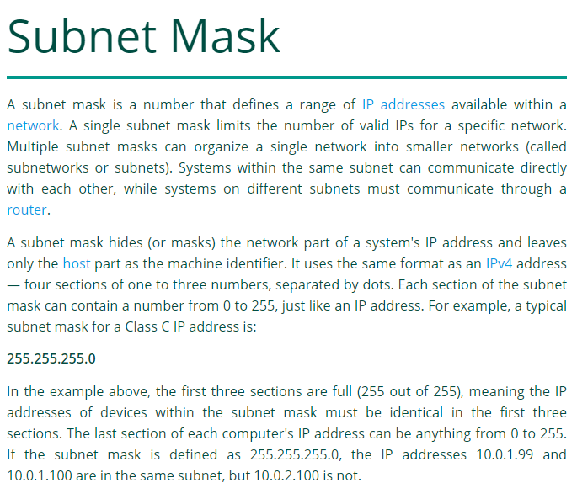

Slide 31
Hosts Calculation Using Subnet Mask, Why Subnet Mask?
Bits Borrowed -> 2
Subnet Mask -> 255.192.0.0/10 -> 11111111 11000000 00000000 00000000 11000000 -> [ 128 + 64 = 192 ] , [ 32 + 16 + 8 + 4 + 2 + 1 = 63 ] Total Host -> (256-192) * (256) * (256) -> 4,194,304
Reserved For Network
Reserved For Hosts
Network # 1
IP Address -> 192.168.1.3 /17
Subnet Mask -> 255.255.128.0 ( Subnet octet is also included because 1 bit is borrowed and here in the subnet octet we write the sum of all the borrowed bits placing value. )
Network # 2
IP Address -> 176.105.1.5 /16
Subnet Mask -> 255.255.0.0 ( Since the CIDR value was 16 therefore, no bit is borrowed that is why the subnet octet is not included in subnet mask calculation. )
The subnet mask tells the router how many bits are allocated for the network and how many for the host. The subnet mask provides a means to organize the IP address space into an ordered hierarchy; it splits the IP address into a network portion and a host portion.

Slide 32
Subnets, Subnet Identification ?
A subnet, or subnetwork, is a segmented piece of a larger network. More specifically, subnets are a logical partition of an IP network into multiple, smaller network segments. The Internet Protocol (IP) is the method for sending data from one computer to another over the internet. Each computer, or host, on the internet, has at least one IP address as a unique identifier. Organizations will use a subnet to subdivide large networks into smaller, more efficient subnetworks. One goal of a subnet is to split a large network into a grouping of smaller, interconnected networks to help minimize traffic. This way, traffic doesn't have to flow through unnecessary routs, increasing network speeds with multiple paths. The Subnet ID is also used by the routers to determine the best route between the subnetworks. Subnets are identified on the bases of the first subnet IP address. For subnets, there are two hosts reserved for the IP addresses needed for the network identity itself (the first IP) and the broadcast address (the last IP). The first IP address of the subnet acts as a subnetwork network ID that helps the router to differentiate two or more subnets.

Slide 33
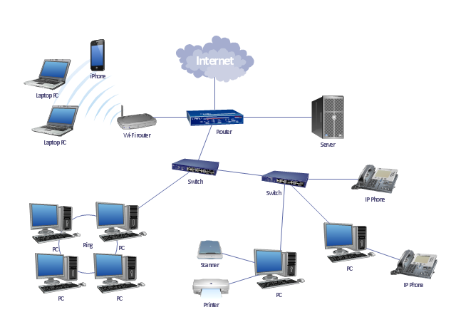
Routers & Switches
Network X
176.54.2.5
132.14.2.7
Network Y
16.24.1.5
Network Z

Slide 34
Routers & Switches (Continued)
The most basic explanation is that a switch is designed to connect computers within a network, while a router is designed to connect multiple networks together. Even though routers and switches are different, they can be used interchangeably. For example, a router typically has several LAN ports and a single WAN port.
If The Connection Is Within The Same Network -> Switches If The Connection Is Between Two Or More Networks -> Routers
Example Of How A Router Calculates Network Id ?
The router checks the IPs of the sender and the receiver and then sends the request of the sender to the receiver by viewing the network id of the receiver with a private path.
Address Space -> 176.168.1.10 (Class B)
Network Id -> 176.168.0.0 ( Host Octets -> 0 )

Slide 35
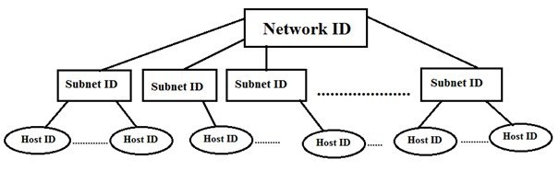

Slide 36
Subnet Identification ?
CIDR → 22 Subnet # 1 → 176.5.0.0/22 → 176.5.3.255/22 Subnet # 2 → 176.5.4.0/22 → 176.5.7.255/22 Subnet # 3 → 176.5.8.0/22 → 176.5.11.255/22 Randomly Selected IP Within Subnet # 3 Range → 176.5.9.10/22 Subnet # 4 → 176.5.12.0/22 → 176.5.15.255/22 Subnet # N → 176.5.[(N-1)*4].0/22
Step # 1 ( Calculate Subnet Mask Of The IP ) Network Network Subnet Host IP Address → 176.5.9.10/22 → 11111111 11111111 11111100 00000000 Replace Network Octets → 255 Replace Subnet Octet → ( Sum Of Placing Values Of All 1’s )
Replace Host Octets → 0
Therefore, Subnet Mask → 255.255.(128+64+32+16+8+4).0 → 255.255.252.0 Step # 2 ( Find The Nearest Multiple )
256 – ( New Subnet Octet Value From Subnet Mask ) → 256 – 252 = 4 Let X = 4
Now, find the nearest multiple of X that is lesser or equal to the older subnet octet value in original IP.
0 4 8 <= 9
Let Y = 8
Network ID → 176 .5.Y.0/22 ; Y = Subnet Octet Value ; Therefore, Subnet ID → 176.5.8.0/22 Now, For ending or broadcast range add Y + (remaining host bits placing values in subnet octet) Therefore, 8 + [ 2^1 + 2^0 (remaining host bits are only 2) ] Broadcast Id → 176.5.(8+3).0/22

Slide 37
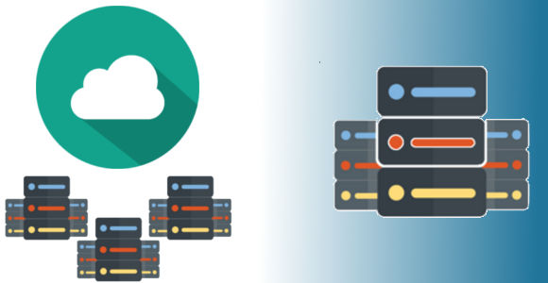
Virtual Network
Physical Network

Slide 38
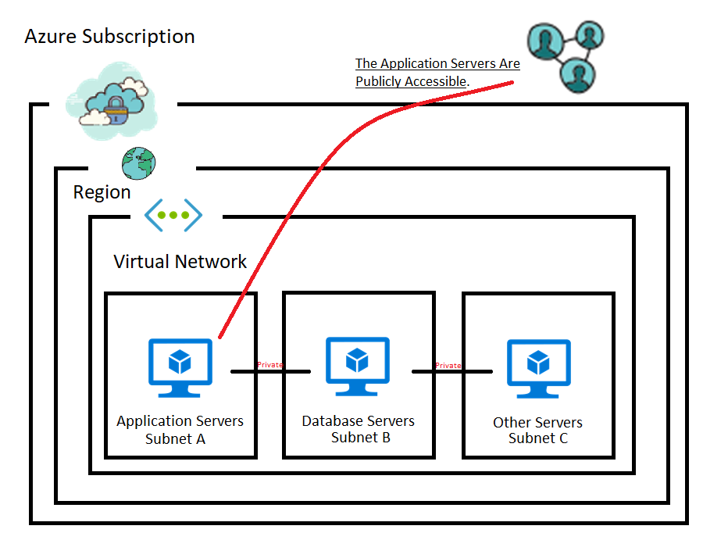

Slide 39
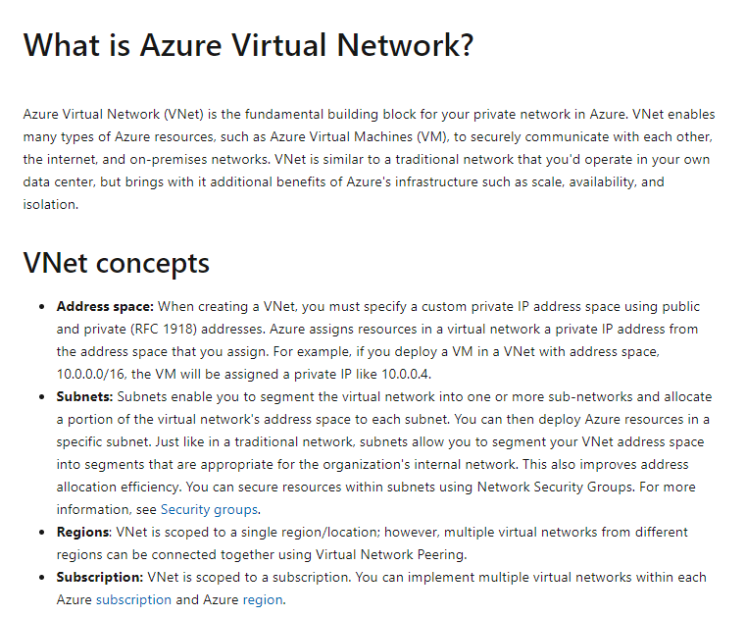

Slide 40
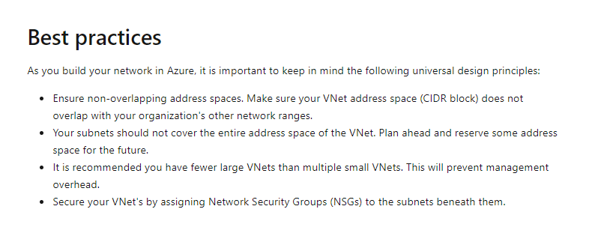

Slide 41
How To Create A Virtual Network At Microsoft Azure ?

Slide 42
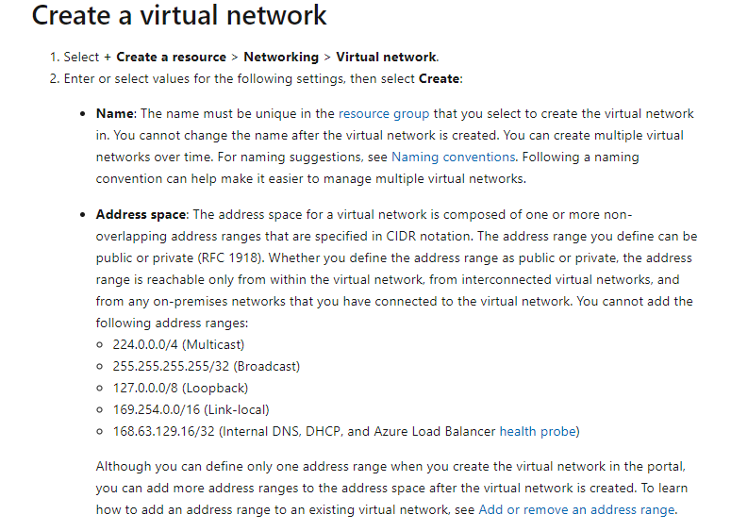
***Important***

Slide 43
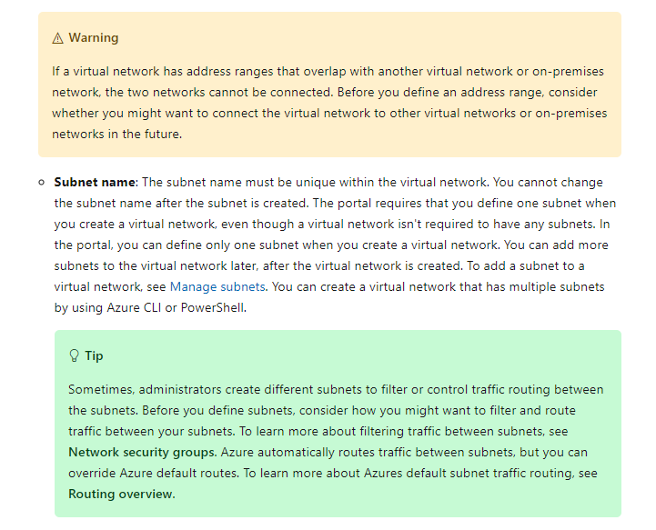
***Important***

Slide 44
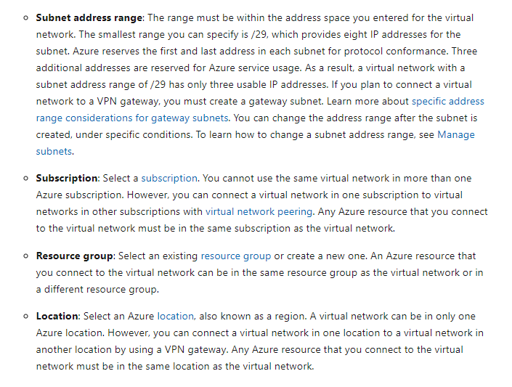

Slide 45
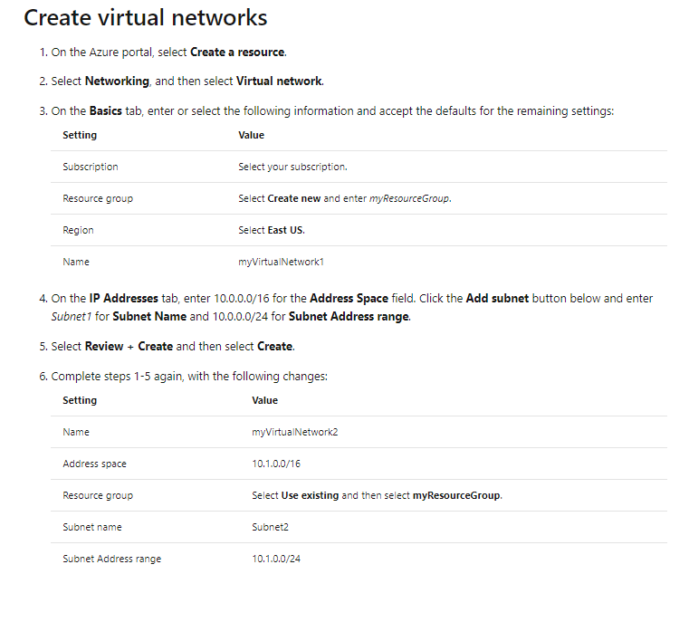

Slide 46
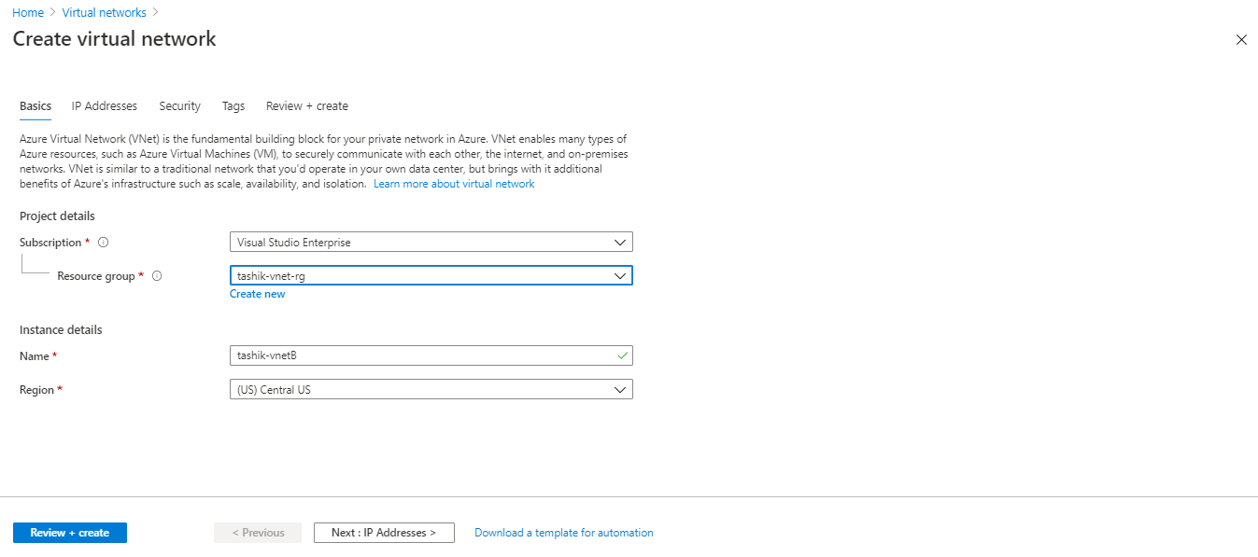

Slide 47
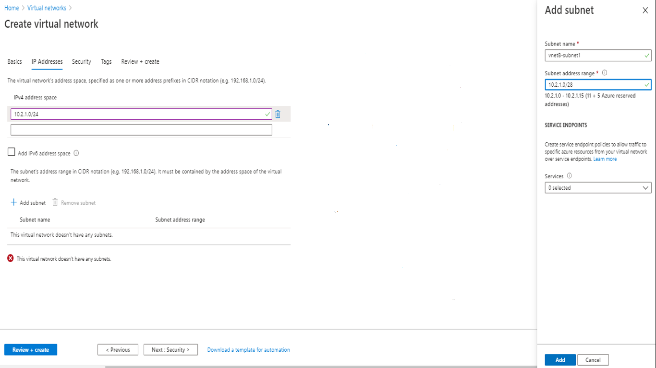

Slide 48
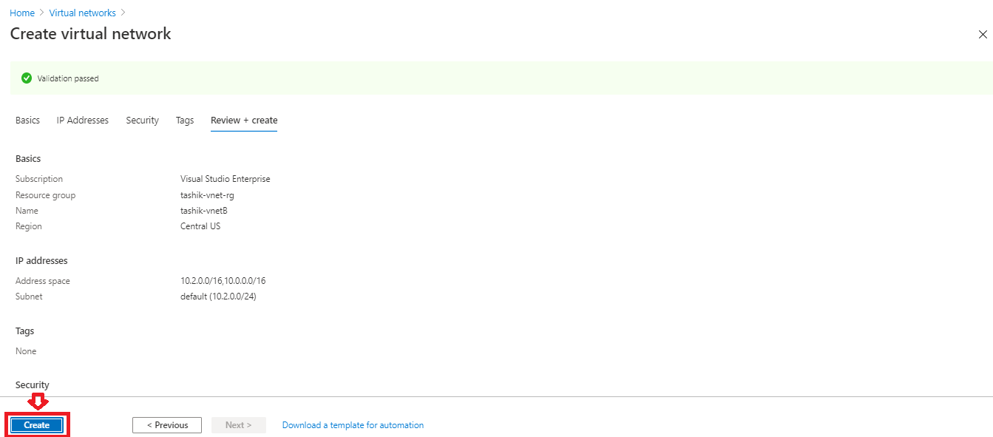

Slide 49
Communication Of Virtual Machines Within Same Network With No Subnets.

Slide 50



Azure Subscription
Azure Region
Virtual Network
VM # 1
VM # 2
VM # 3
VM # 4
VM # N

Slide 51
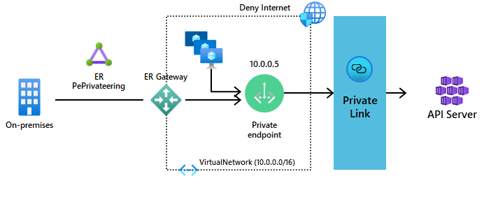
No Internet Needed For Communication
Internet + Public IP Of VM Of VNET

Slide 52
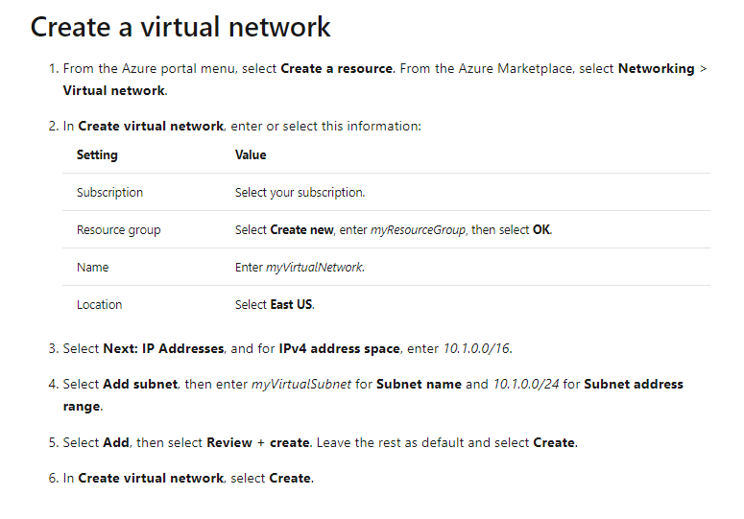

Slide 53
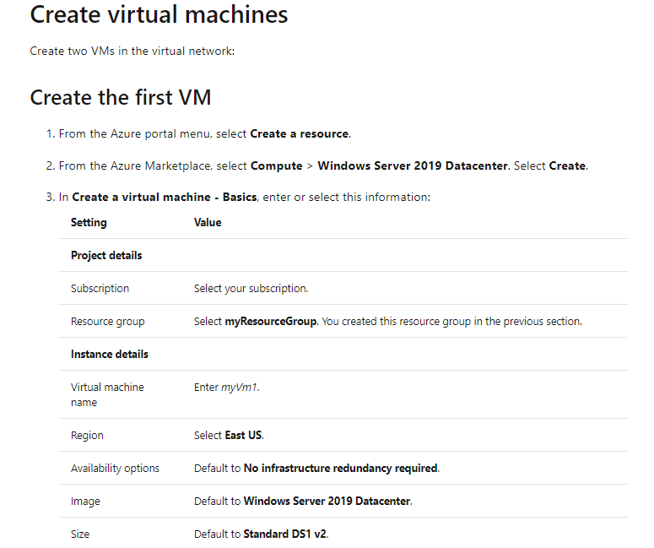

Slide 54
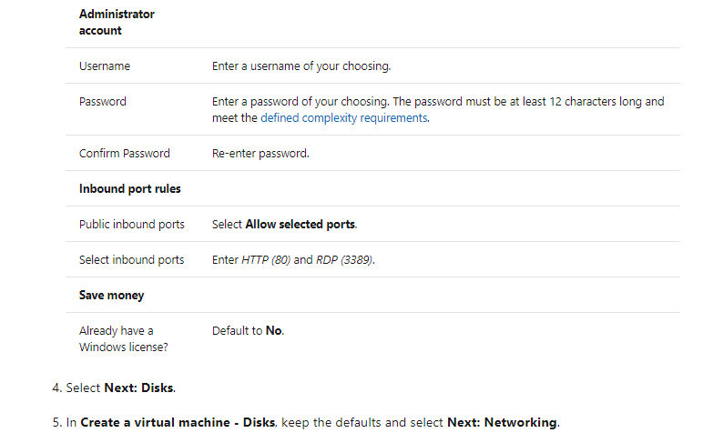

Slide 55
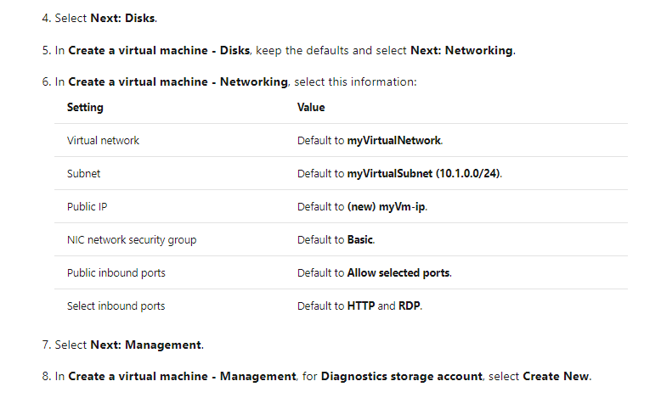

Slide 56
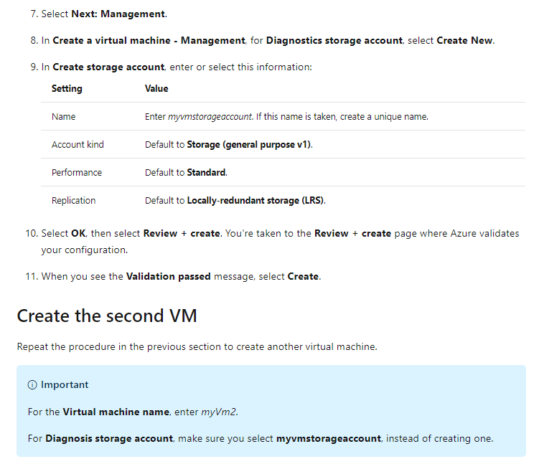
Note: Step 7,8,9 Aren’t Required You Can Leave Them As It Is For Now.

Slide 57
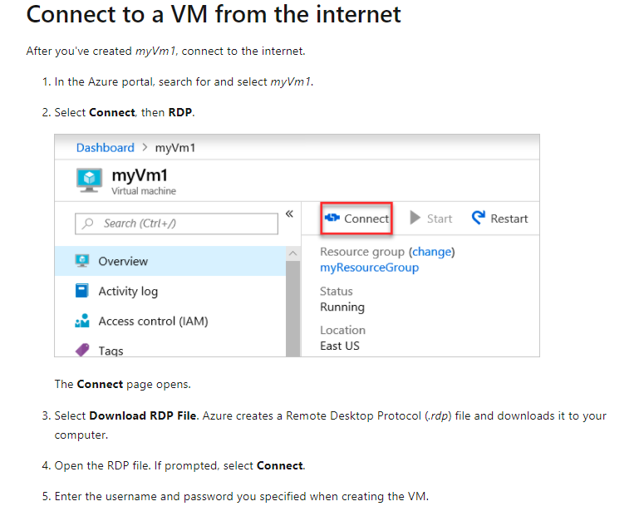

Slide 58
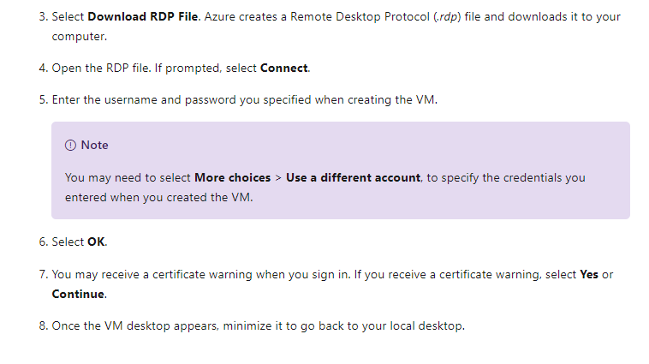

Slide 59
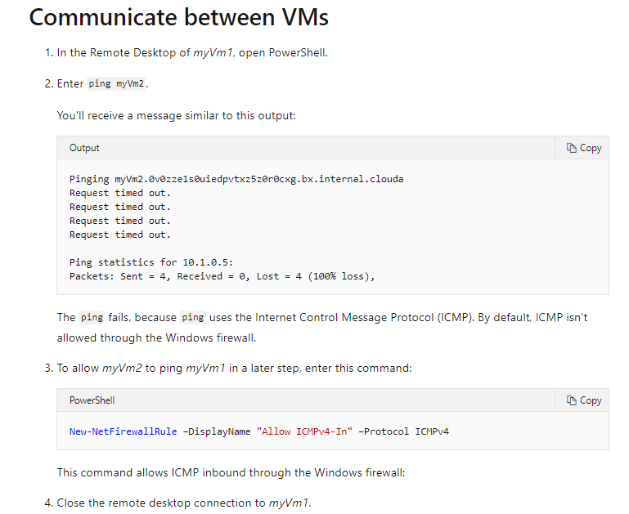
Note: Step 3 Is Very Important.
***Important***

Slide 60
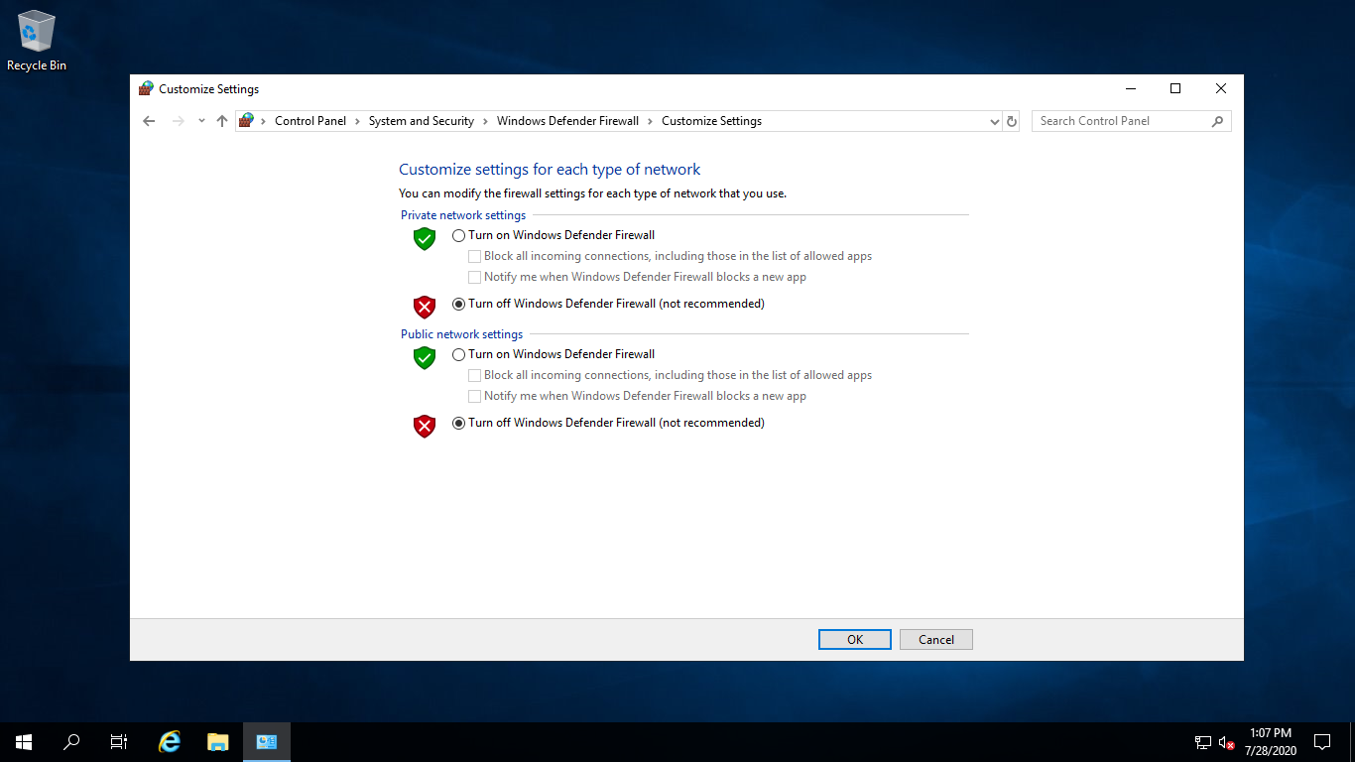
***Important***

Slide 61
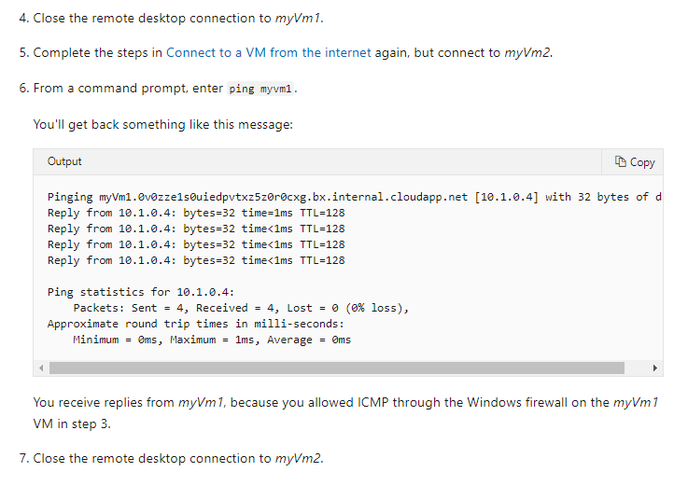
Note: Do Not Forget To Disable The Windows Firewalls Of Both The Virtual Machines.
***Important***

Slide 62
Communication Of Virtual Machines Of Different Subnets Of Same Network

Slide 63
Azure Subscription
Azure Region
Virtual Network
Subnet A
Subnet B
Direct Communication
No Peering
VM # 1
VM # 2

Slide 64
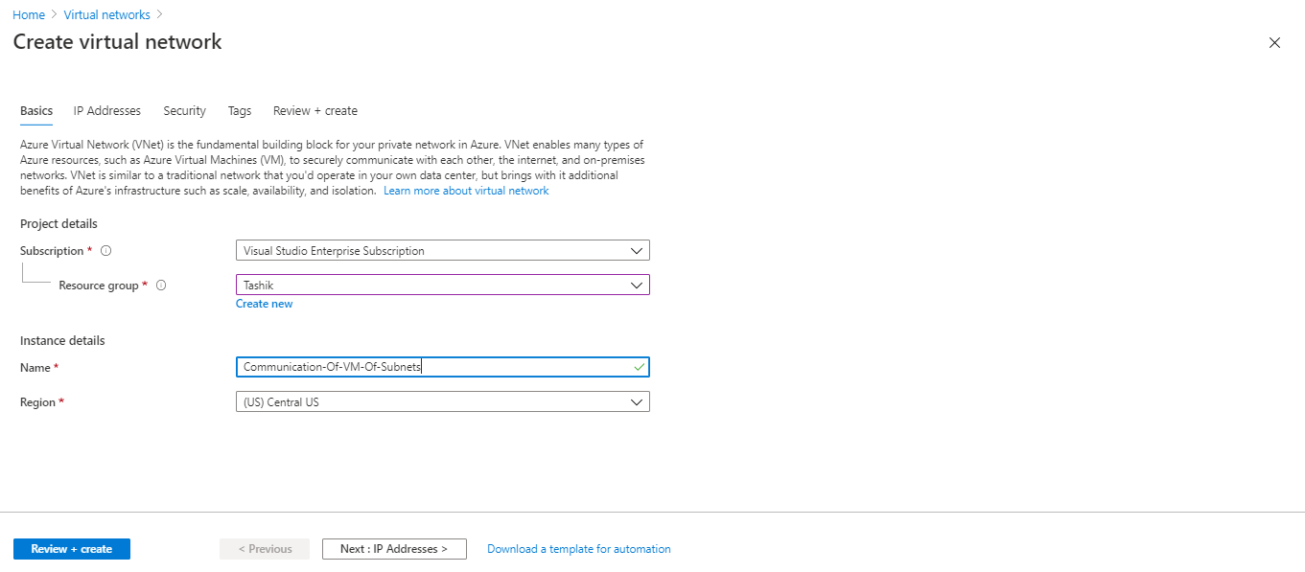

Slide 65
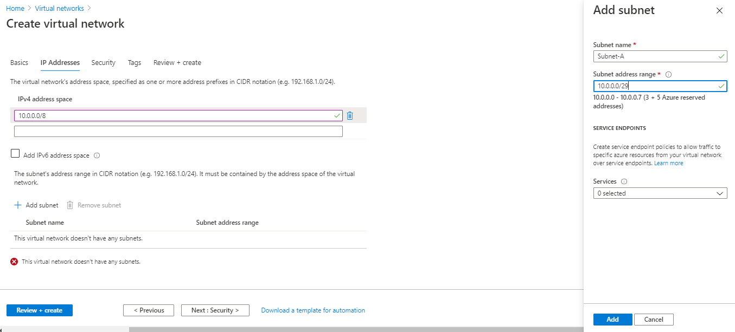

Slide 66
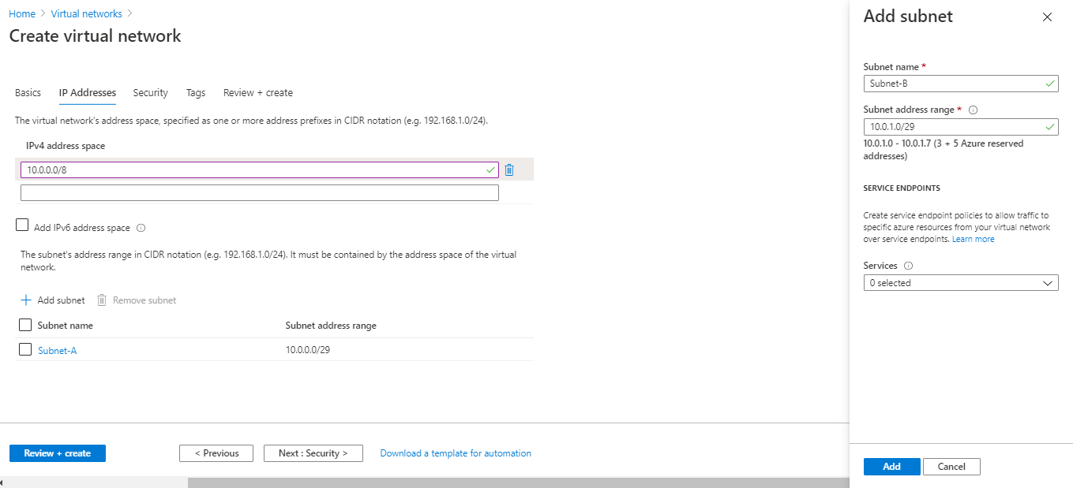
Change Network Octets Value Only To Avoid Overlapping. We Can Not Change Subnet Or Host Identifiers/Octets To Avoid Overlapping Between The Subnets.

Slide 67


Slide 68


Slide 69


Slide 70


Slide 71


Slide 72

Note: We can directly do communication between the subnets without peering with private IP only.

